Slide 1
Introduction Description of the Problem and Background Scenario: I am planning to visit USA end of this year. It was a longtime Dream that I wanted to visit New York since my childhood. I am kind of excited that I can leverage this opportunity to find some interesting places that I can visit while I am at NY especially coffee shop. It my compulsory activity to try the coffee at new places that I'm visiting. The Key Questions: what are the coffee shops within NY City?

Slide 2
DATA
Data that will be used is from New York city geographical coordinates data will be utilized as input for the Foursquare API, that will be leveraged to provision venues information for each location. We will use the Foursquare API to explore the mentioned venues in New York City.
How the data will be used to solve the problem:
The data will be used as follows: Use Foursquare and geopy data to map the venues for coffee shops clustered in groups (as per Course LAB) Use foursquare and geopy data to map the location of coffee shops , separately and on top of the above clustered map in order to be able to identify the venues. Create a map that depicts, for instance, the locations and nearby shops with the particular radius.

Slide 3
Data Mapping
The Following maps were created to facilitate the analysis and the choice of the coffee shops.
Methodology
This section represents the main component of the report where the data is gathered, prepared for the analysis.

Slide 4
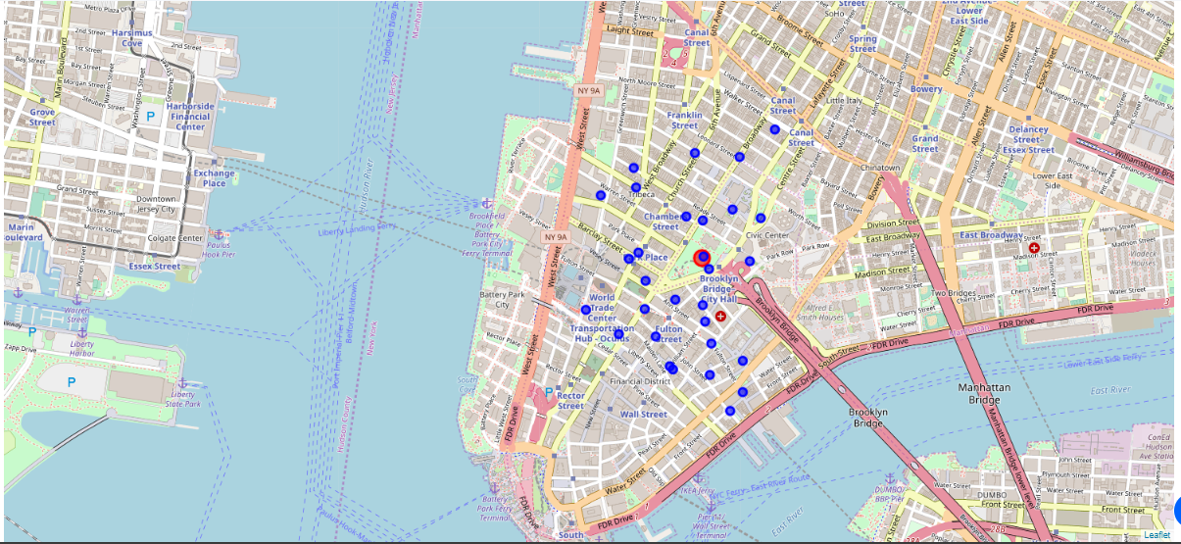
Result

Slide 5
Cont : result
After examining the map, I have chosen one location that can be quite convincing that is five coffee Roasters.
This is because of the location which is at Liberty Plaza. Using the “one map’ above, I was able to explore all possibilities since the popups provide the information needed for a good decision which is For Five Coffee Roasters.

Slide 6
Discussion
I feel this Capstone project presented me a great opportunity to practice and apply the Data Science tools and methodologies learned.
Conclusion
In the nutshell, this project has showed me the way to identify and explore data in more advanced version to process it. The mapping with Folium is a very powerful technique to consolidate information and make the analysis and decision thoroughly and with confidence.
I would recommend for use in similar situations.

